Slide 1


ATIEN'S CAFÉ AND DIM SUM HOUSE
Personal Chef & Catering Service
Presented by: Suprihatin for CODINGMUM SG BATC2

Slide 2
Contents
Explanation of my project
Live demo
Questions?!

Slide 3
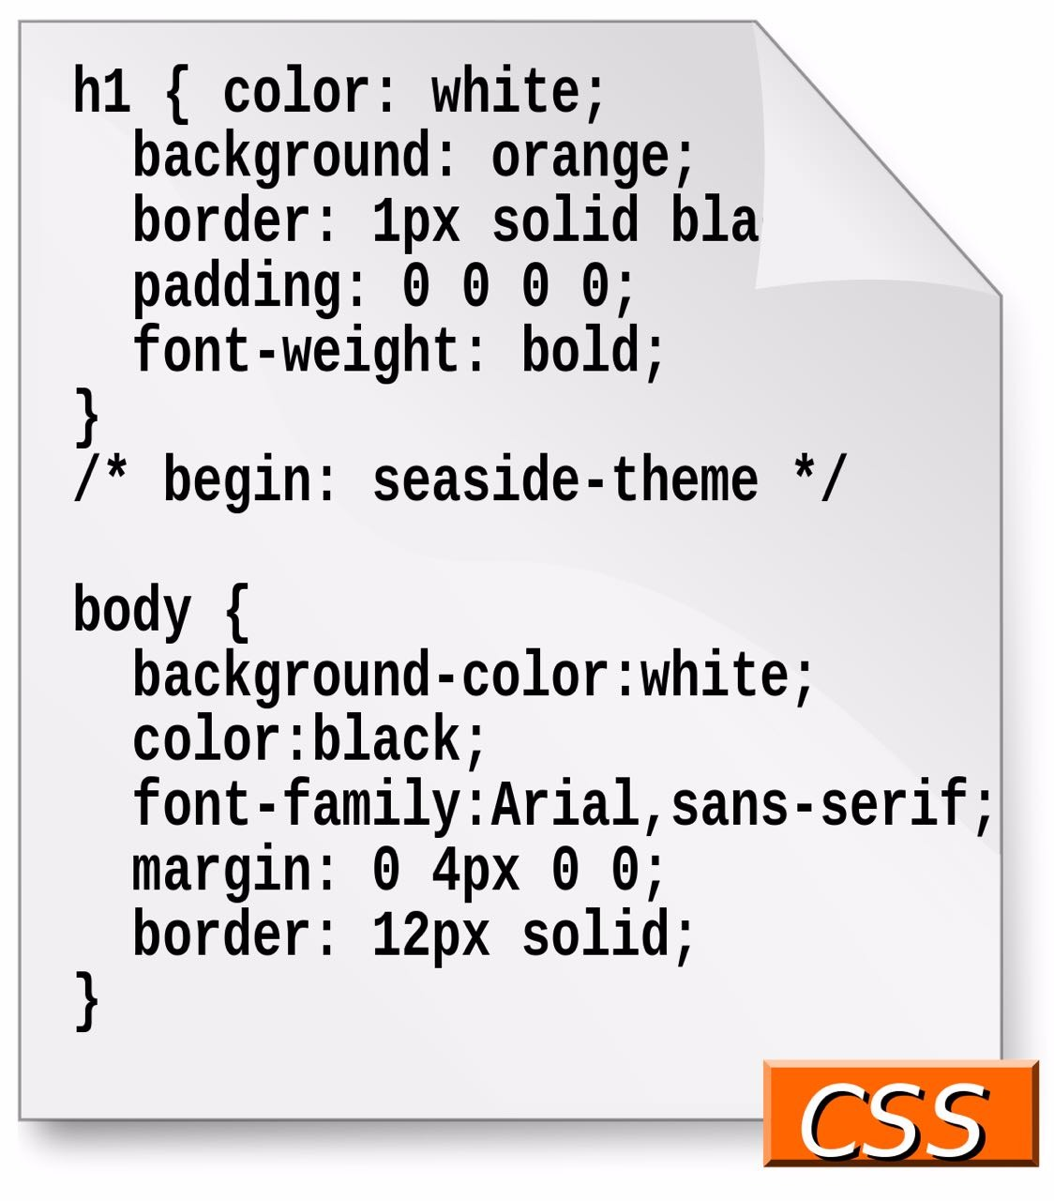
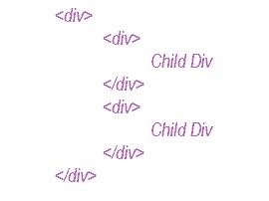

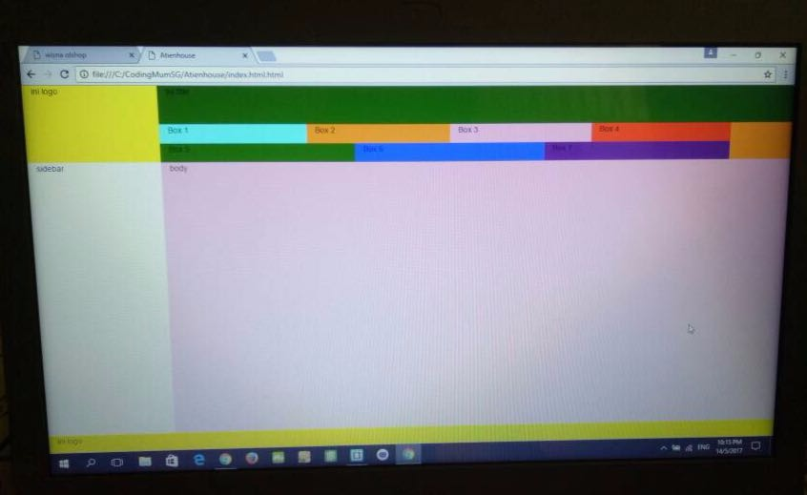
Explanation of my project
Benefits of Creating a website:
Introduce the company to the public
Save budget marketing, because the website is a sales 24h nonstop
Can function as an online catalog to support sales / advertising
Expand the market
Facilitate in spreading information
What I have learned:

Slide 4
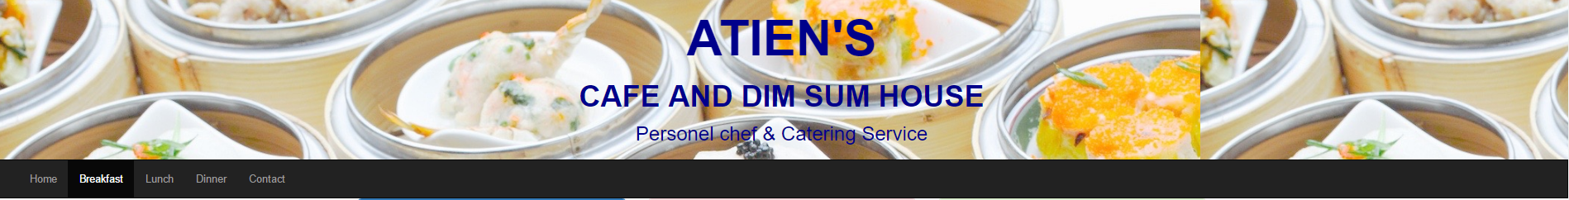
Live Demo
Atien's Café
Home page with main menu:
Home/Breakfast/Lunch/Dinner/Contact

Slide 5
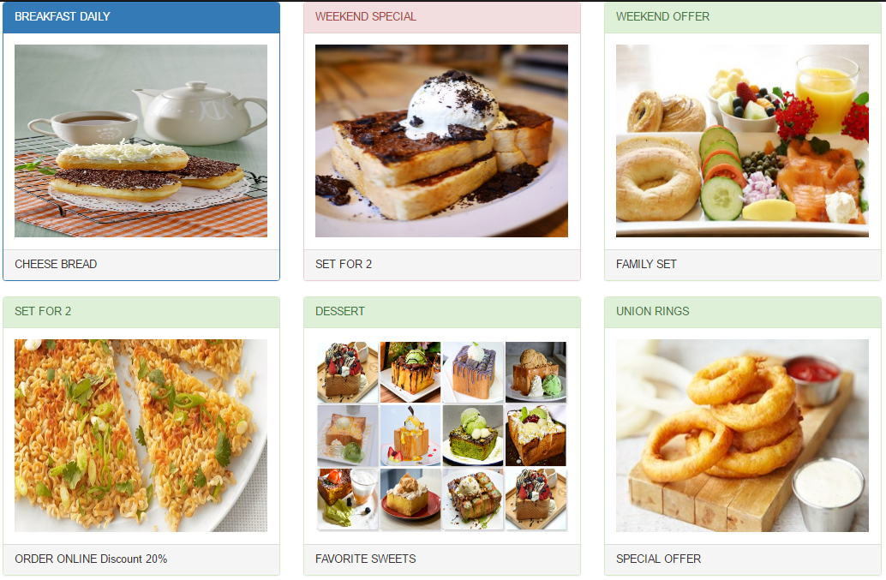
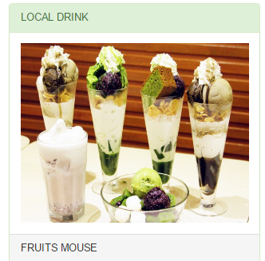
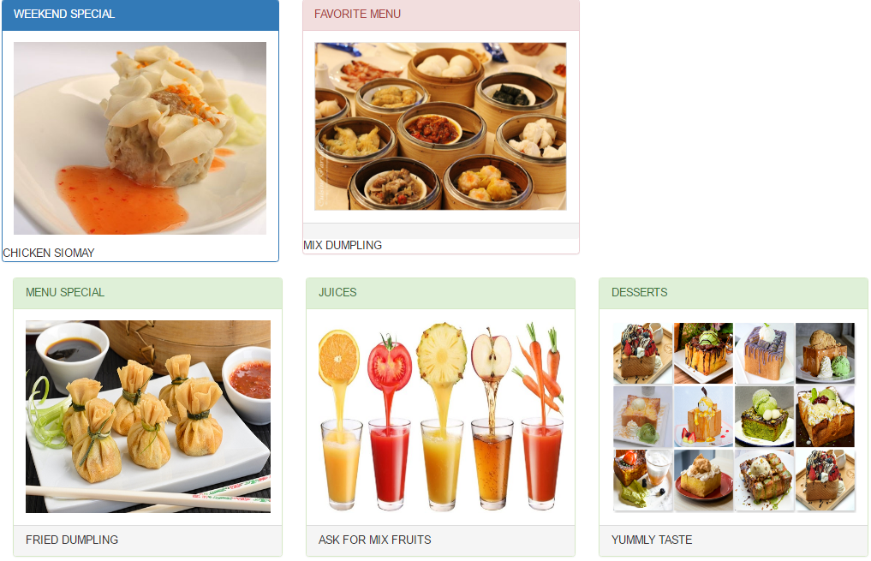
Breakfast & Lunch
Breakfast:
Lunch:

Slide 6
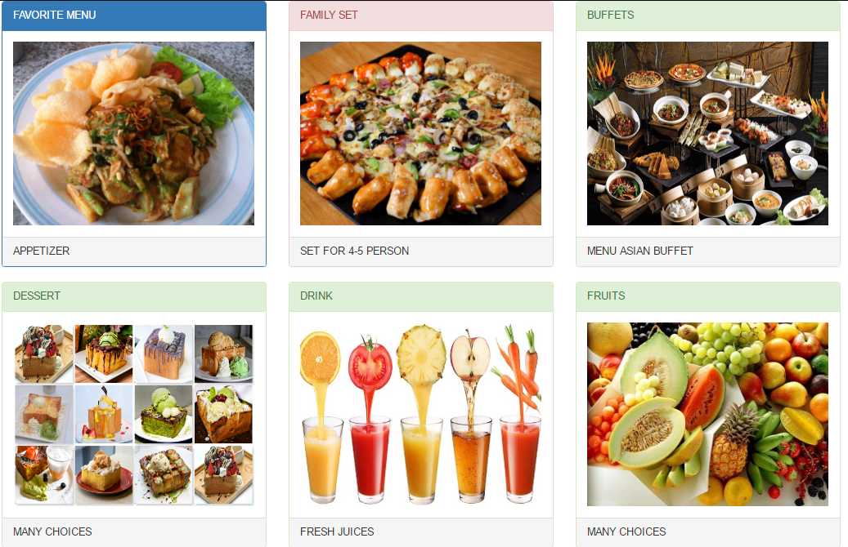
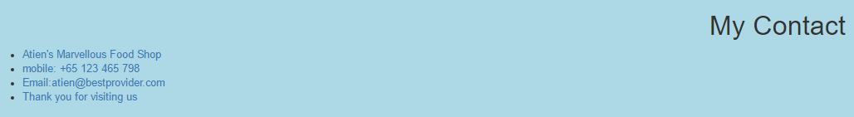
Dinner & how to contact the Café
Dinner:

Slide 7
Questions?!

Slide 8
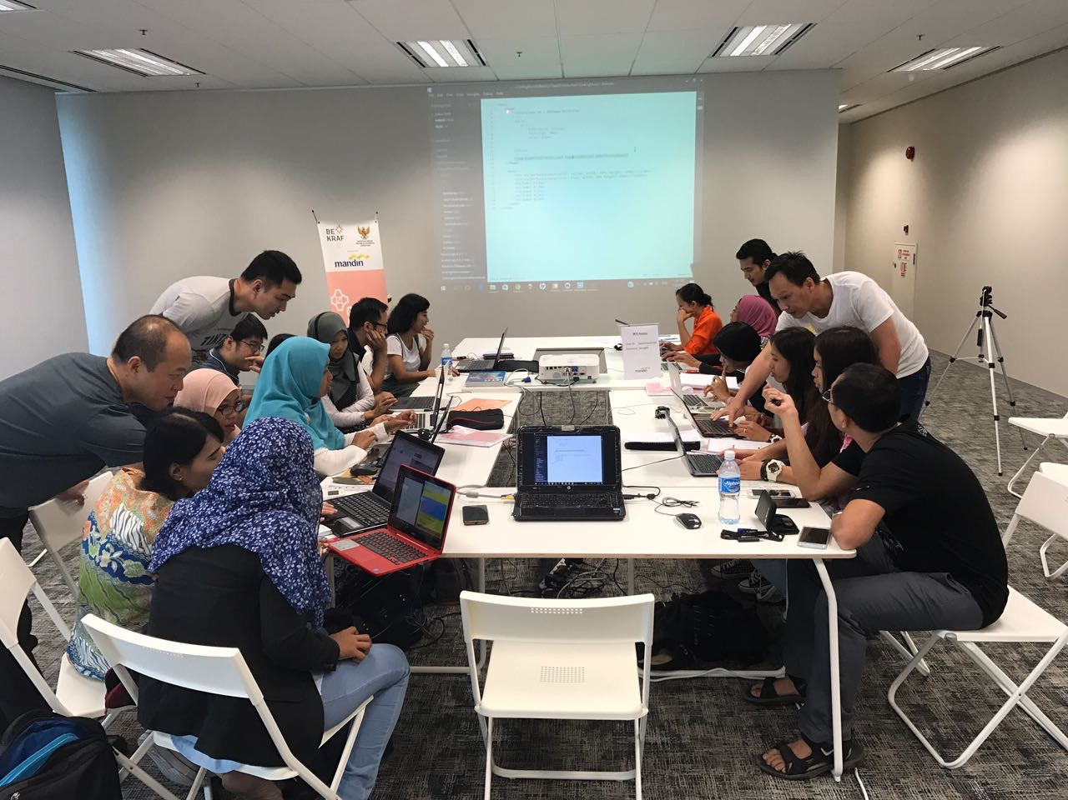
THANK YOU
Organizers of
Sponsor
And Counselors

